Slide 1
Developing Teachers’ Mindsets for Students to Achieve
Materials and Information provided by TNTP

Slide 2
Do Now
Discuss excerpt from Teaching As Leadership entitled “Kindhearted Lowered Expectations”
Notes:
Bell, Ross, Lamb, Dalton-Clarks
Guiding Questions:
What's the first student that came to mind after you read this text?
Do you think the student can still learn if their needs aren't met?

Slide 3
Objectives
Recognize actions and mindsets that indicate when a belief in all students’ ability to achieve is not being upheld.
Identify the root causes of the fixed mindsets that exist in our building and relate them to the idea of equality.
Notes:
Geary, Brooks, Lewis

Slide 4
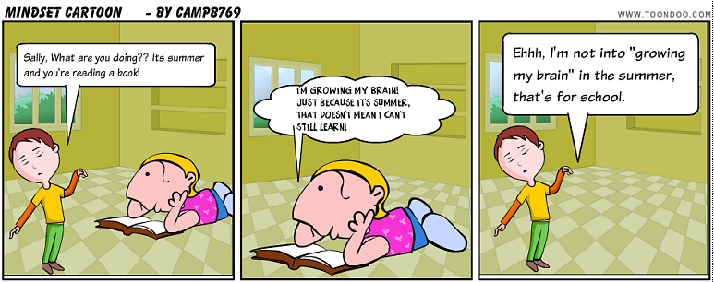
Agenda
The impact of mindset
Mindsets
Building a growth mindset
Notes:
Bell, Cross, Winchester

Slide 5
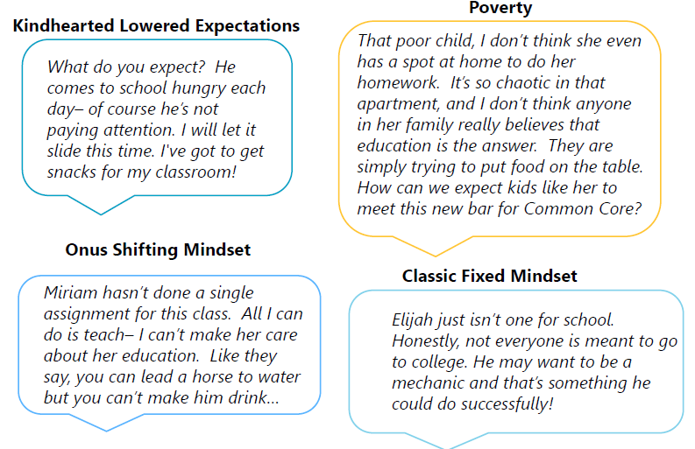
Mindsets Reveal Themselves
Notes:
Bell, Cross, Flint
Guiding Questions:
What are the differences between kindhearted lowered expectations, poverty,
What are the differences between onus shifting mind, and classic fixed mindset?
Are there any similarities between any of the mindsets? If so, which ones and why?

Slide 6
Timed-Pair-Share
What were your thoughts on the video, what stood out to you?
Teacher will announce a topic.
Students will have think time.
Students will pair with their partner.
When teacher says “share,” students will share their response aloud with their partner at a voice level 1, starting with person A.
Notes:
Bell, Cross, Winchester

Slide 7
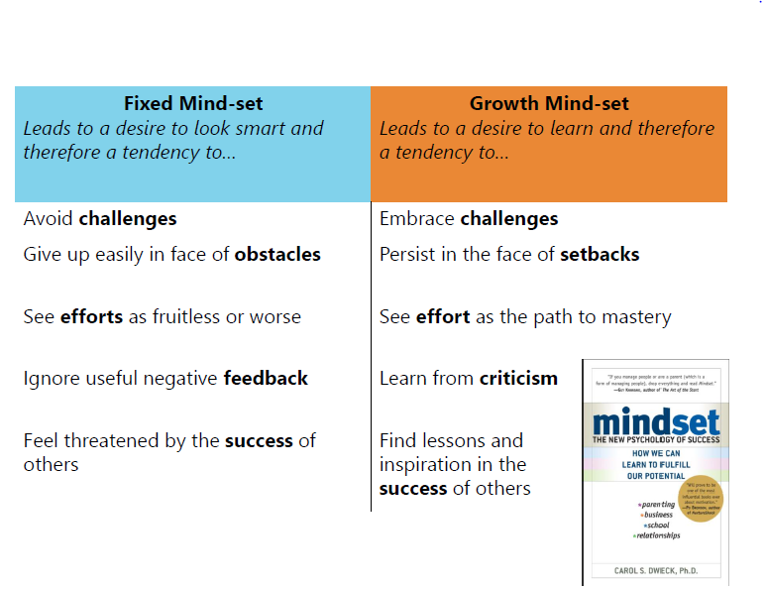
What is a growth mind-set exactly?
Notes:
Geary, Brooks, Lewis

Slide 8
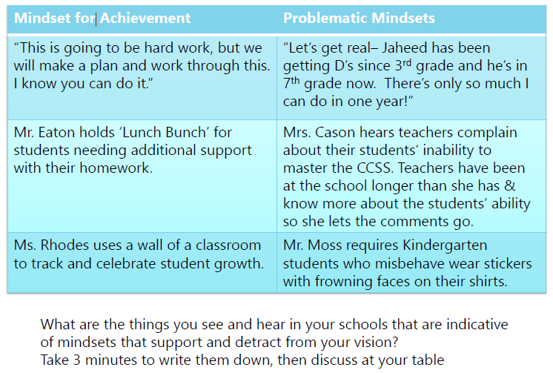
Mindsets in Your Building
Notes:
Bell, Ross, Lamb, Dalton-Clarks

Slide 9
Think-Write-Share
Teacher will announce a topic.
Students will have think time.
Students will silently write their answers on their paper.
When teacher says “share,” students will share their response aloud with their teams at a voice level 1, starting with person 1.
Notes:
Bell, Cross, Winchester

Slide 10
Mindsets in Our Building
Examples
Type of Mindset
Strategy
Notes:
Bell, Cross, Winchester
Create a T chart in cooperative groups to create an anchor chart and classify each mindset.
Work in pairs or groups to create an anchor chart to record and report out. Each cluster should have an anchor chart (distraction to vision or assistance to vision).
6 minutes(3 minutes to write and 3 minutes to share) Turn negatives into growth opportunities
Teachers will generate a mindset poster to be hung in the cluster room and referred to when needed

Slide 11
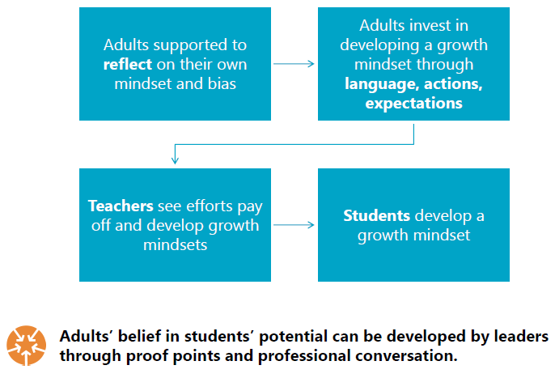
Practice → Habits → Beliefs
Notes:
Brooks, Geary, Lewis

Slide 12
Exit Ticket
Reflect and complete mindset chart.
Notes:
Bell, Cross, Winchester
Things needed: same colored pens, chart paper/blank paper
3 leadership members needed to transcript the exit tickets to be shared with TAP leadership and School Leadership teams: Ross(2-3), Brooks(Enrichment), T. Bell(PK-1), M. Bell (4-5), Cross(6-8)
Next TAP leadership team meeting= create next steps POSSIBLY

